Slide 1


Slide 2

Good Morning, Utrecht

Slide 3
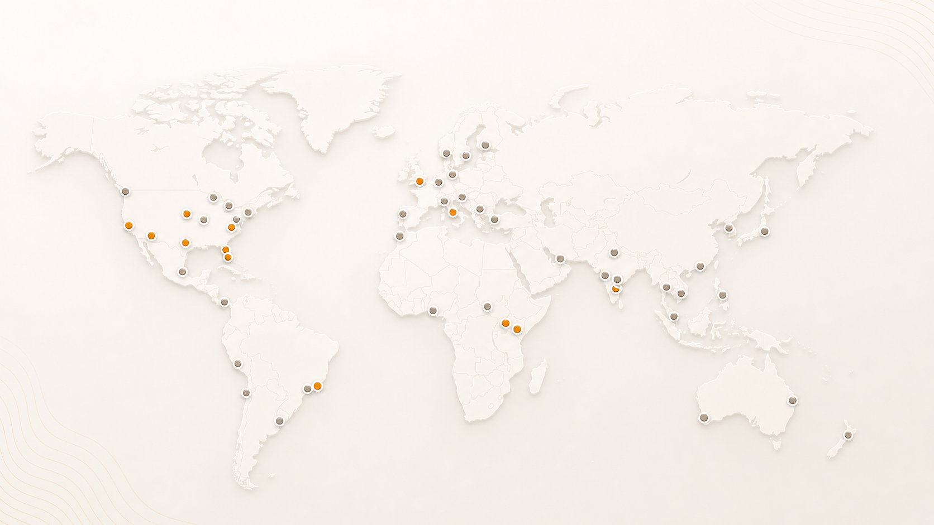
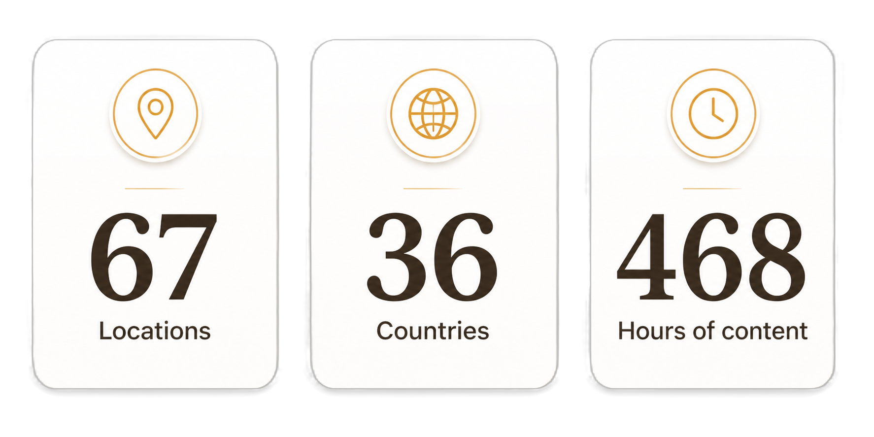
AgentCon around the world

Slide 4
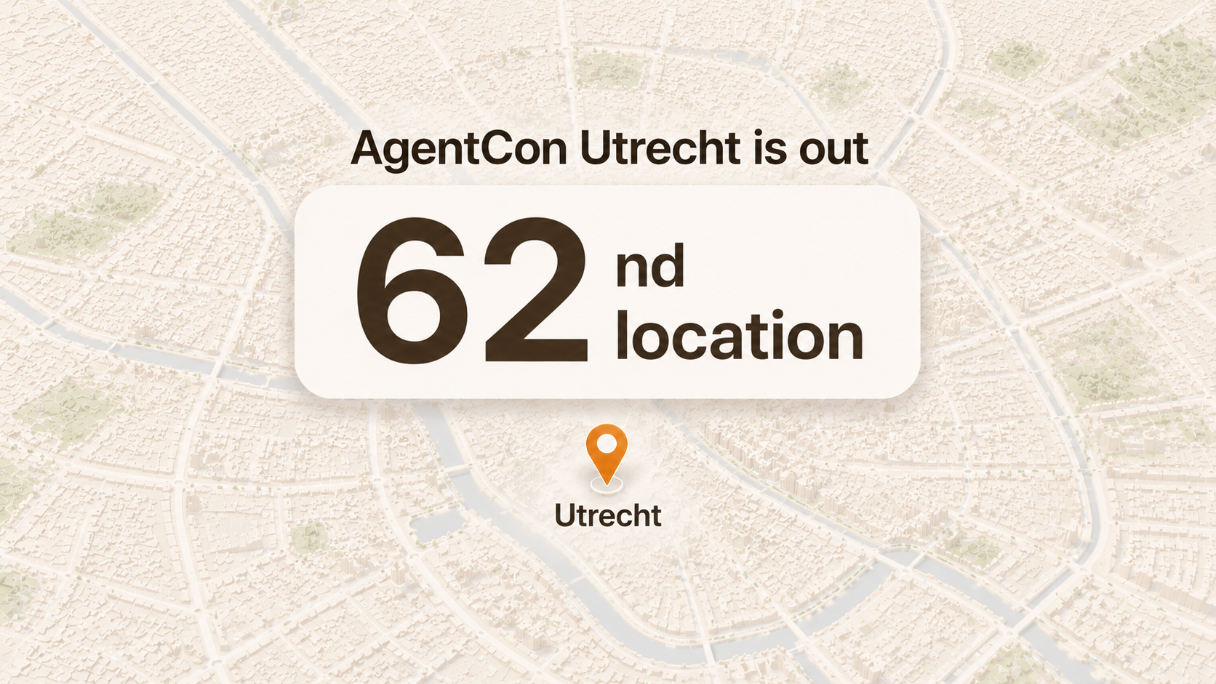

Slide 5
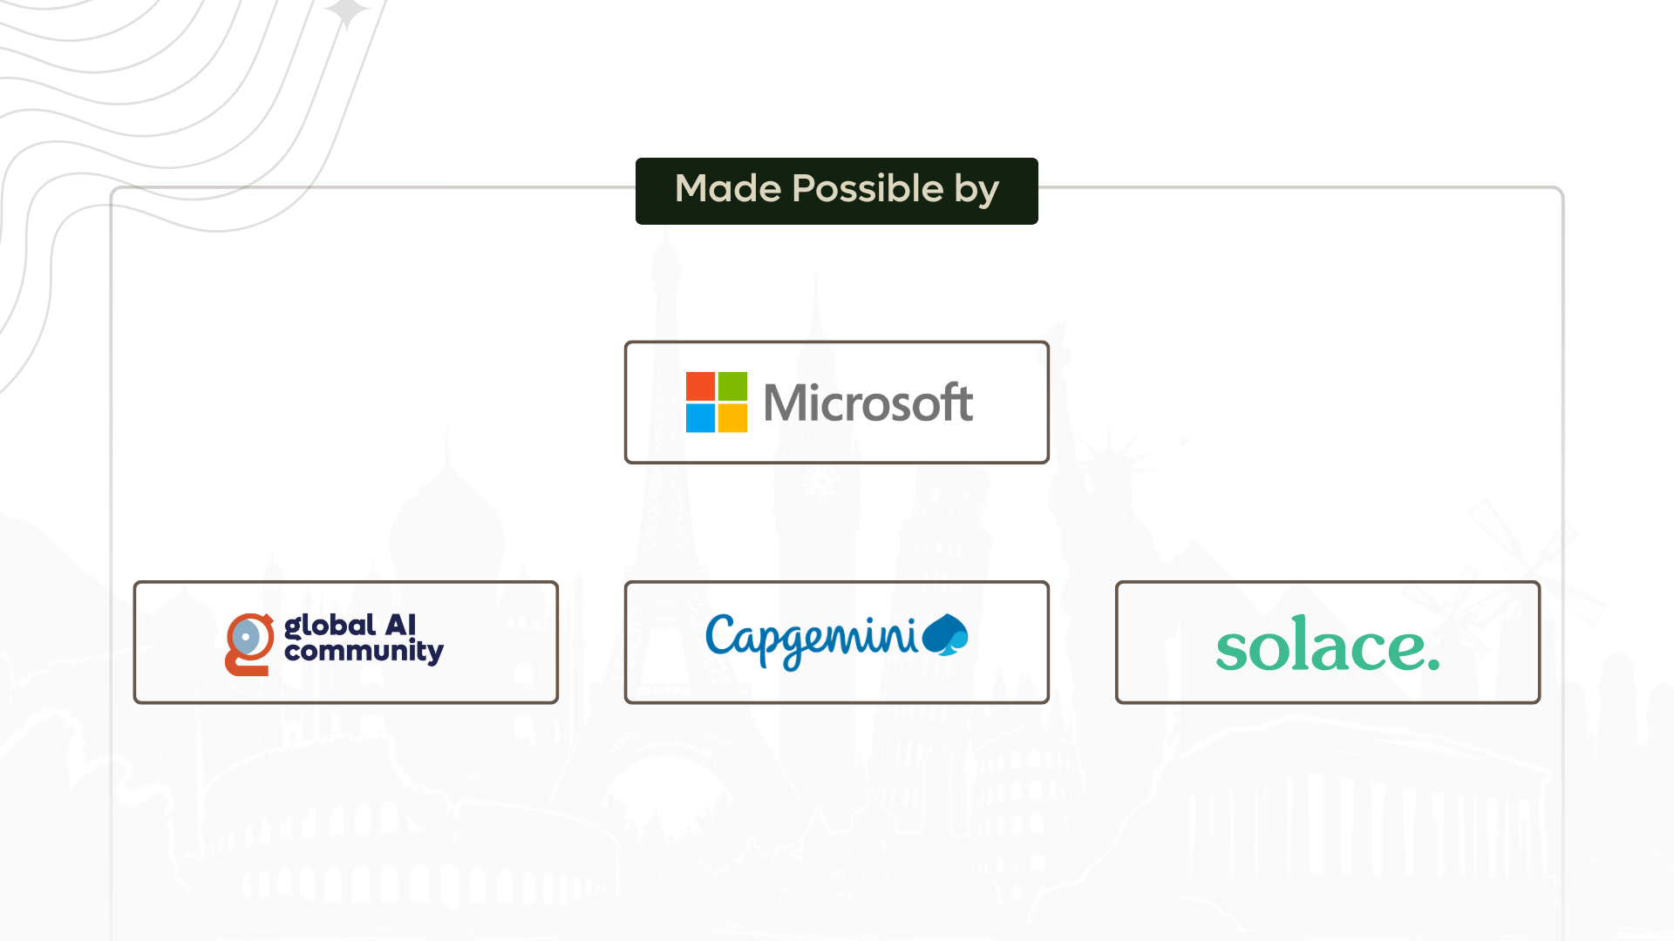

Slide 6
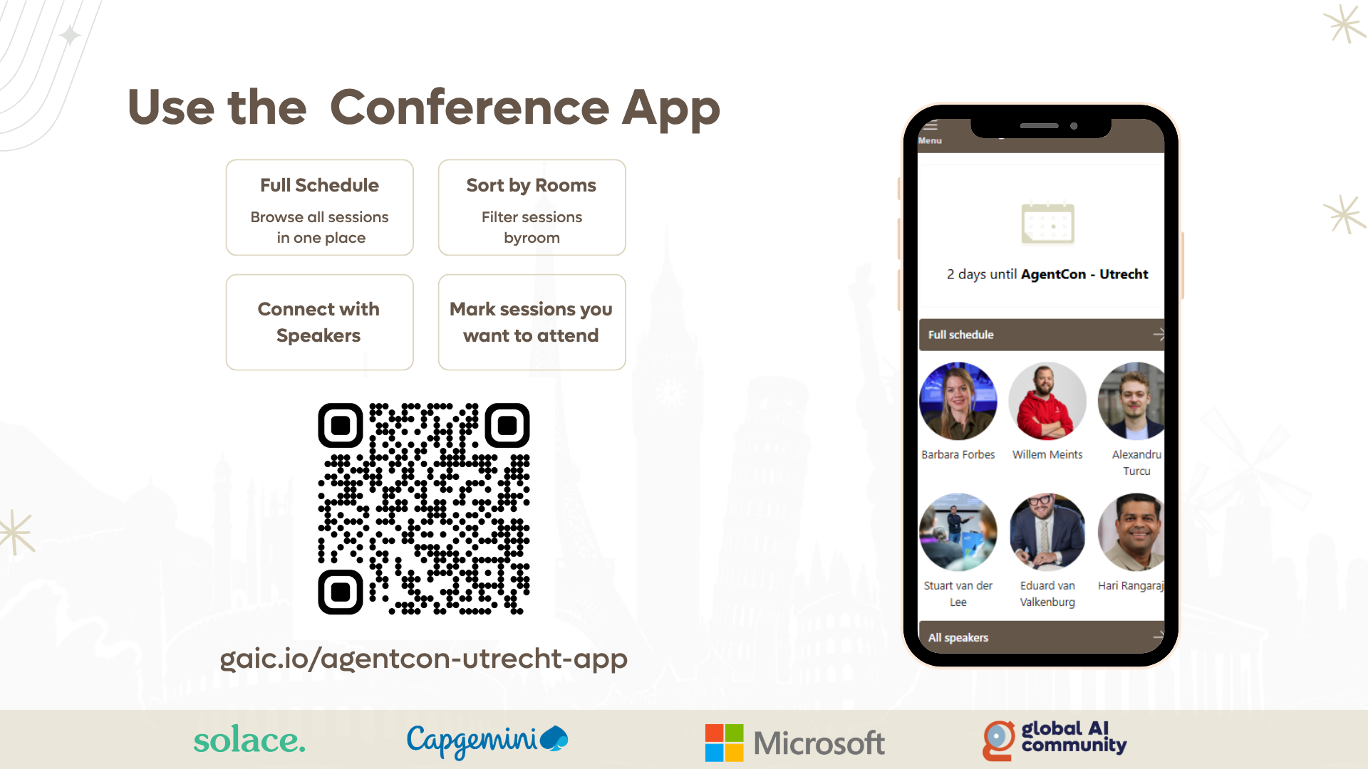

Slide 7


Slide 8
08:30 AM -09:30 AM
Registrations
09:30 AM – 09:45 AM
Welcome
Keynote: Marco Casalaina
The Evolution of Agents at Microsoft and Everywhere
09:45 AM – 10:45 AM
10:45 AM – 11:00 AM
Coffee Break
11:00 AM – 12:25 PM
Session
12:30 PM - 01:15 PM
Lunch Break
01:15 PM – 02:40 PM
Sessions
01:15 PM – 02:40 PM
Workshop
02:45 PM - 03:00 PM
Coffee Break
03:00 PM – 04:25 PM
Sessions
03:00 PM – 04:25 PM
Workshop
04:30 PM - 05:00 PM
Closing Remarks

Slide 9
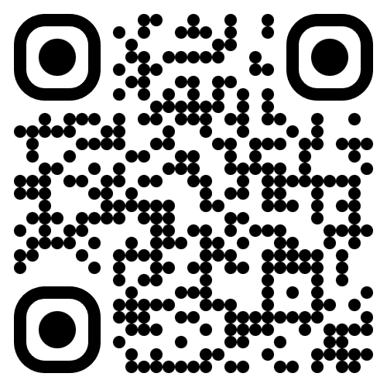
Join the AI Conversation on Discord
gaic.io/discord

